Slide 1
Self-censorship in China: an experimental design
Hao Wang

Slide 2
Purpose
Do Chinese citizens censor themselves?
Who is more likely to conduct self-censor behaviors?
Study sensitive questions using survey experiment.

Slide 3
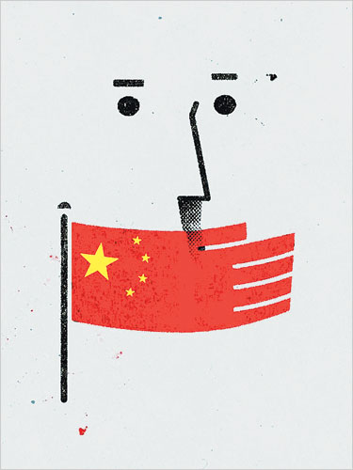
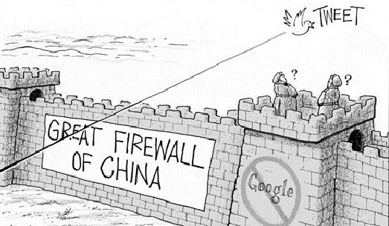
Censorship

Slide 4
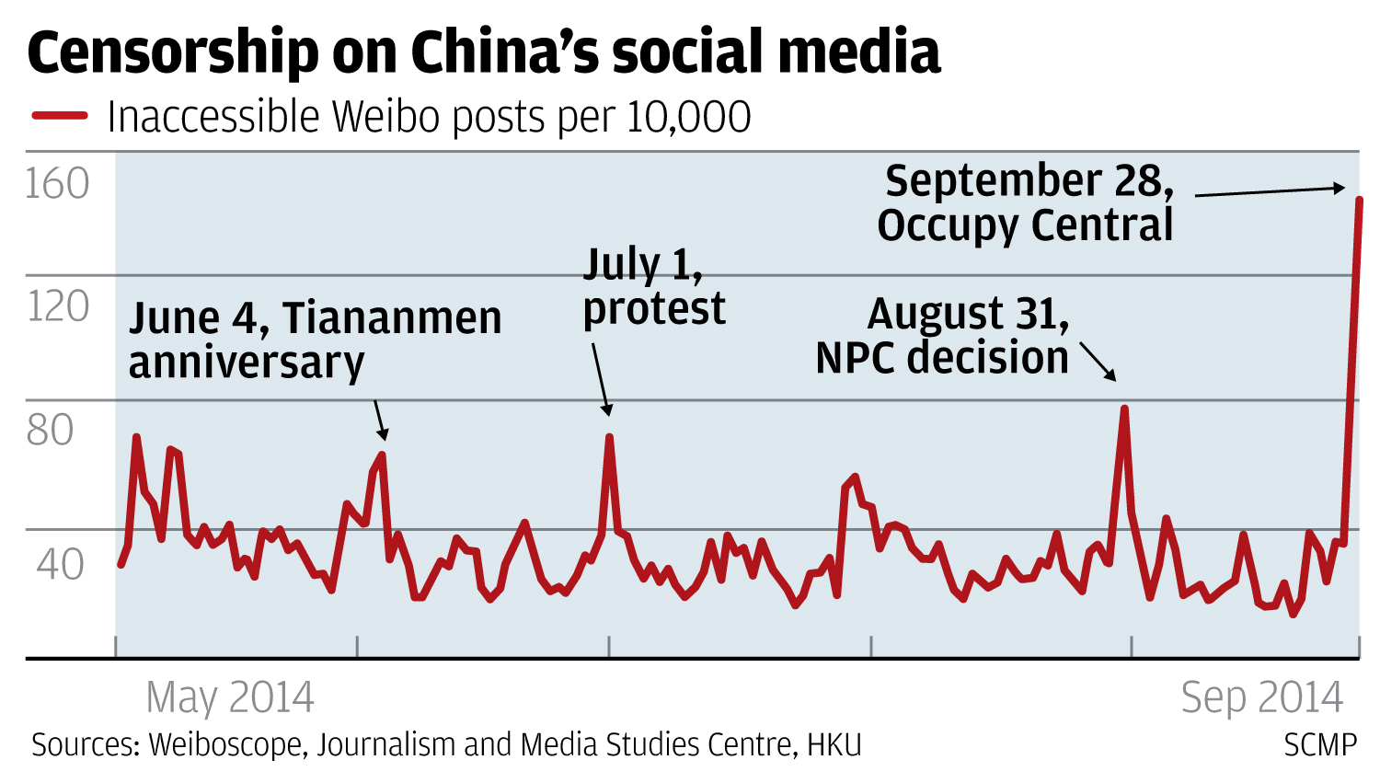
Censorship in Practice
Great Fire Wall (Golden Shield Project) : certain websites like google, facebook, twitter, Instagram are blocked in China.
Real-time Internet censoring: online comments including certain contents will be filtered out

Slide 5
Self-censorship
In authoritarian countries, citizens censor themselves.
Evidence:
Tsai 2007: Revealing true preferences in Authoritarian countries may be diﬃcult because many questions are sensitive.
Wang 2009: Even for online comments, citizens are hesitated to voice their true opinions.

Slide 6
Puzzle
If traditional surveys cannot reveal the true opinion, how to obtain valid data in authoritarian countries like China?
The results from opinion surveys will NOT be valid!

Slide 7
List Experiment
Instead of asking the question directly, list experiment asks respondents indirectly.
Respondents are divided randomly into control group and treatment group
Control group (T 0 ) will be assigned with N non-sensitive issues.
Treatment group (T 1 ) will be assigned with N+1 issues, the added one is the political sensitive issue which we are interested in.
Asking respondents how many issues do they support in two groups and compare the mean.

Slide 8
Why list experiment can detect levels of self-censorship?
Respondents are only required to provide the number of arguments they agree/disaggree – protect their anonymity
By comparing the diﬀerence mean values we get the estimated proportion of population who agree/disagree with the sensitive issue.

Slide 9
Example: control group
Now I’m going to read you 4 opinions about contemporary China. After I read all four, just tell me HOW MANY of them do you agree. Control group (4 non-sensitive opinions)
1 People hold the government’s accountability.
2 China has its own distinctive features, Western political system may not be practical in China.
3 We should value the integrity of China’s territory.
4 Reform and Open policy has dramatically increased people’s living standard, but it enlarges the income gap between the rich and the poor.

Slide 10
Example : treatment group
The four non sensitive questions in control group, plus one sensitive question:
Government officials are corrupted and politicians should be elected by people.

Slide 11
Detect levels of self-censorship
The level of censorship is the DIFFERENCE of between list experiment and direct surveys.
Pr(favor election |list experiment) = Mean(Treatment − Control )
Pr(censorship bias) = Pr(favor election|list experiment) – Pr(favor election | direct survey)

Slide 12
QUESTIONS!

